Slide 1
THEOREM
  If f and g are two one-to-one functions, then their composition that is gof is one-to-one.
  PROOF
  We are taking functions f: X →Y and g: Y →Z are both one-to-one functions.
  Suppose x₁, x₂ ∈X such that (gof) (x₁) = (gof) (x₂) ⇒g(f(x₁)) = g(f(x₂)) (definition of composition)
  Since g is one-to-one, therefore f(x₁) = f(x₂)
  And since f is one-to-one, therefore x₁ = x₂
  Thus, we have shown that if (gof) (x₁) = (gof)(x₂) then x₁ = x₂
  Hence, gof is one-to-one.
THEOREM
  If f: X→Y and g: Y → Z are both onto functions, then gof:X → Z is onto.
  PROOF
  Suppose f: X →Y and g: Y →Z are both onto functions. We must show that gof: X →Z is onto. Let z∈Z Since g:Y →Z is onto, so for z∈Z, there exists y∈Y such that g(y)=z. Further, since f: X →Y is onto, so for y∈Y, there exists x∈X such that f(x) = y.
  Hence, there exists an element x in X such that (gof) (x) = g(f(x)) = g(y) = z
  Thus, gof: X →Z is onto.

Slide 2
THEOREM
  If f: W →X, g:X →Y, and h:Y →Z are functions, then
  (hog)of = ho(gof)
  PROOF
  The two functions are equal if they assign the same image to each element in the domain, that is,
  ((hof)of)(x) = (ho(gof)) (x) for every x ∈W
  Computing
  ((hog)of)(x) = (hog)(f(x)) = h(g(f(x)))
  and (ho(gof)) (x) = h ((gof)(x)) = h (g(f(x)))
  Hence (hog)of = ho(gof)
  REMARK: The composition of functions is associative.
EXERCISE
  Suppose f:X→Y and g:Y→Z and both of these are one-to-one and onto. Prove that (gof)⁻¹ exists and that
  (gof)⁻¹ = f⁻¹og⁻¹
  SOLUTION
  Suppose f: X →Y and g:Y →Z are bijective functions, then their composition gof: X →Z is also bijective. Hence (gof)⁻¹: Z →X exists.
  Next, to establish (gof)⁻¹ = f⁻¹og⁻¹, we show that
  (f⁻¹og⁻¹)o(gof) = i_{x} and (gof)o(f⁻¹og⁻¹) = i_{z}

Slide 3
  Now consider
  (f⁻¹og⁻¹)o(gof) = f⁻¹o(g⁻¹o(gof)) (associative law for o)
  = f⁻¹o((g⁻¹og)of) (associative law for o)
  = f⁻¹o(i_{y}of) (g⁻¹og = i_{y})
  = f⁻¹of (i_{y}of = f)
  = i_{x} (f:X→Y)
  Also
  (gof)o(f⁻¹og⁻¹) = go(fo(f⁻¹og⁻¹)) (associative law for o)
  = go((fof⁻¹)og⁻¹) (associative law for o)
  = go(i_{y}og⁻¹) (fof⁻¹ = i_{y})
  = gog⁻¹ (i_{y}og⁻¹ = g⁻¹)
  = I_{z} (g:Y→Z)
  Hence f⁻¹og⁻¹ = (gof)⁻¹
REAL-VALUED FUNCTIONS
  Let X be any set and R be the set of real numbers. A function f:X→R that assigns to each x∈X a real number f(x) ∈R is called a real-valued function.
  If f: R →R, then f is called a real-valued function of a real variable.
  EXAMPLE
  1.f: R⁺ →R defined by f(x) = log x is a real valued function.
  2. g:R →R defined by g(x) = e^{x} is a real valued function of a real variable.

Slide 4
OPERATIONS ON FUNCTIONS
  SUM OF FUNCTIONS
  Let f and g be real valued functions with the same domain X. That is f:X →R and g:X →R.
  The sum of f and g denoted f+g is a real valued function with the same domain X i.e. f+g: X →R defined by
  (f+g)(x) = f(x) + g(x) ∀ x∈X
  EXAMPLE
  Let f(x) = x² + 1 and g(x) = x + 2 defines functions f and g from R to R.
  Then (f+g) (x) = f(x) + g(x)
  = (x² + 1) + (x + 2)
  = x² + x + 3 ∀x∈R
  which defines the sum functions f+g: X →R
DIFFERENCE OF FUNCTIONS
  Let f: X →R and g:X →R be real valued functions. The difference of f and g denoted f-g is a function from X to R defined by
  (f-g)(x) = f(x) - g(x) ∀ x∈X
  EXAMPLE
  Let f(x) = x² + 1 and g(x)=x+2 define functions f and g from R to R. Then (f-g) (x) = f(x) - g(x)
  = (x² + 1) - (x + 2)
  = x² - x - 1 ∀x∈R
  which defines the difference function f-g: X →R

Slide 5

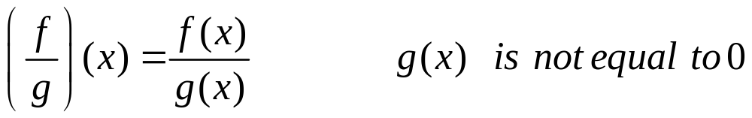
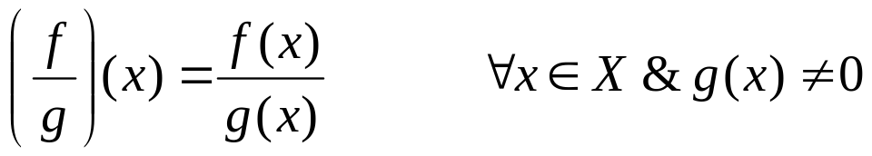
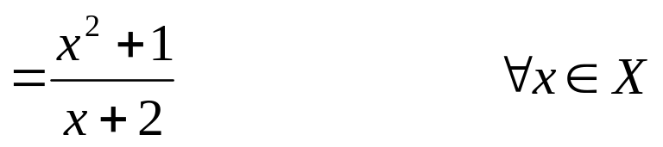
PRODUCT OF FUNCTIONS
  Let f: X →R and g:X →R be real valued functions. The product of f and g denoted f.g or simply fg is a function from X to R defined by
  (f . g)(x) = f(x) . g(x) ∀ x∈X
  EXAMPLE
  Let f(x) = x² + 1 and g(x)=x+2
  define functions f and g from R to R.
  Then (f . g) (x) = f(x) . g(x)
  = (x² + 1) . (x + 2)
  = x³ + 2x² + x + 2 ∀x∈R
  which defines the product function f . g: X →R
QUOTIENT OF FUNCTIONS
  Let f:X→R and g: X →R be real valued functions. The quotient of
  f by g denoted is a function from X to R defined by
  EXAMPLE
  Let f(x) = x² + 1 and g(x) = x + 2 defines functions f and g from R to R.
  Then
which defines the quotient function : X →R.

Slide 6
SCALAR MULTIPLICATION
  Let f:X →R be a real valued function and c is a non-zero number. Then the scalar multiplication of f is a function c⋅f: R →R defined by
  (c⋅f)(x) = c⋅f(x) ∀x∈X
  EXAMPLE
  Let f(x) = x² + 1 and g(x) = x+2 defines functions f and g from R to R. Then
  (3f - 2g)(x) =(3f)(x) - (2g)(x)
  =3 ⋅ f(x) - 2 ⋅ g(x)
  = 3(x²+1) - 2 (x+2)
  = 3x² - 2x-1 ∀x∈X
EXERCISE
  If f:R →R and g:R → R are both one-to-one, is f+g also one-to-one?
  SOLUTION
  f+g is not one-to-one
  As a counter example; define f:R →R and g: R →R by
  f(x) = x and g(x) = -x ∀x∈R
  Then obviously both f and g are one-to-one
  Now
  (f+g)(x) = f(x) + g(x) = x + (-x) = 0 ∀x∈R
  Clearly f+g is not one-to-one because
  (f+g)(1) = 0 and (f+g) (2) = 0 but 1≠2

Slide 7
EXERCISE
  If f:R→R and g:R →R are both onto, is f+g also onto? Prove or give a counter example.
  SOLUTION
  f+g is not onto.
  As a counter example, define f:R →R and g:R →R by
  f(x) = x and g(x) = - x ∀x∈R
  Then obviously both f and g are onto.
  Now (f+g)(x) = f(x) + g(x)
  = x + (-x)
  = 0 ∀x∈R
  Clearly f+g is not onto because only 0∈R has its pre-image in R and no non-zero element of co-domain R is the image of any element of R.
EXERCISE
  Let f:R →R be a function and c(≠ 0)∈R.
  1. If f is one-to-one, is c⋅f also one-to-one?
  2. If f is onto, is c⋅f also onto?
  SOLUTION
  1. Suppose f:R →R is one-to-one and c(≠ 0)∈R
  Let (c⋅f)(x₁) = (c⋅f)(x₂) for x₁, x₂ ∈ R
  ⇒ c⋅f (x₁) = c⋅f (x₂) (by definition of c⋅f)
  ⇒ f(x₁) = f(x₂) (dividing by c≠0)
  Since f is one-to-one, this implies
  x₁ = x₂
  Hence c⋅f; R →R is also one-to-one.

Slide 8

  2. Suppose f:R →R is onto and (c≠0) ∈R.
  Let y ∈R. We search for an x ∈R such that
  (c⋅f) (x) = y (1)
  ⇒ c⋅f(x) = y (by definition of c⋅f)
  ⇒ f(x) = (dividing by c≠0)
  Since f: R →R is onto, so for ∈R, there exists some x∈R
  such that the above equation is true; and this leads back to equation (1).
  Accordingly c⋅f: R →R is also onto.
EXERCISE
  The real-valued function 0_{x}:X →R which is defined by
  0_{x}(x) = 0 for all x ∈X
  is called the zero function (on X).
  Prove that for any function f: X →R
  1. f + 0_{x} = f 2. f ⋅0_{x} = 0_{x}
  SOLUTION
  1. Since (f + 0_{x})(x) = f(x) + 0_{x}(x)
  = f(x) + 0
  = f(x) ∀x∈X
  Hence f+0_{x} = f

Slide 9
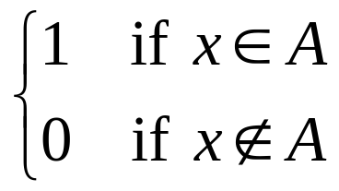
  2. Since (f ⋅ 0_{x})(x) = f(x) ⋅ 0_{x}(x)
  = f(x) ⋅ 0
  = 0
  = 0_{x}(x) ∀x∈X
  Hence f ⋅ 0_{x} = 0_{x}
EXERCISE
  Given a set S and a subset A, the characteristics function of A, denoted χ_{A}, is the function defined from S to the set {0,1} defined as
  χ_{A}(x) =
  Show that for all subsets A and B of S
  1. χ_{A∩B} = χ_{A} ⋅ χ_{B}
  χ_{A∪B} = χ_{A} + χ_{B} - χ_{A} ⋅ χ_{B}
  χ_{A}(x) = 1 - χ _{A}(x)
SOLUTION
  1. Prove that χ_{A∩B} = χ_{A} ⋅ χ_{B}
  Let x ∈ A∩B; therefore x ∈A and x ∈B. Then
  χ_{A∩B}(x) = 1; χ_{A}(x)=1; χ_{B}(x)=1
  Hence χ_{A∩B}(x) = 1 = (1) (1) =χ_{A} (x) χ_{B}(x)
  =(χ_{A} ⋅ χ_{B} ) (x)

Slide 10
SOLUTION
  Next, let y ∈(A∩B)′
  ⇒ y ∈A ′ ∪B ′
  ⇒ y ∈A′ or y ∈B′
  Now y ∈(A∩B)′ ⇒ χ_{(A∩B)}(y) = 0
  and y ∈A′or y ∈B′ ⇒ χ_{A}(y) = 0 or χ_{B}(y) = 0
  Thus χ_{A∩B}(y) = 0 = χ_{A} (y) χ_{B} (y)
  = (χ_{A} ⋅ χ_{B})(y)
  Hence, χ_{A∩B} and χ_{A} ⋅ χ_{B} assign the same number to each element x in S, so by definition
  χ_{A∩B} = χ_{A}⋅ χ_{B}
SOLUTION
  2. Prove that χ_{A∪B} = χ_{A} + χ_{B} - χ_{A} ⋅ χ_{B}
  Let x∈A∪B then x ∈A or x ∈B
  Now χ _{A∪B} (x) = 1 and χ _{A} (x) = 1 or χ _{B} (x) = 1
  Three cases arise depending upon which of χ _{A}(x) or χ _{B}(x) is 1.
  CASE-I (χ _{A}(x)) = 1 & χ _{B}(x) = 1)
  Now χ _{A} (x) + χ_{B} (x) - χ _{A} (x) ⋅ χ_{B} (x)
  = 1 + 1 - (1) (1)
  = 1
  = χ _{A∪B} (x)

Slide 11
  CASE-II (χ _{A} (x) = 1; χ _{B} (x) = 0)
  Now χ _{A} (x) + χ _{B} (x) - χ_{A} (x)⋅ χ_{B} (x)
  = 1 + 0 - (1) (0)
  = 1
  = χ _{A∪B} (x)
  CASE III (χ _{A} (x) = 0; χ _{B} (x) = 1)
  Now χ _{A} (x) + χ _{B} (x) - χ_{A} (x)⋅ χ_{B} (x)
  = 0 + 1 + (0) (1)
  = 1
  = χ _{A∪B} (x)
  Thus in all cases
  χ _{A∪B}(x) = 1 = χ _{A} (x) + χ _{B} (x) - χ_{A} (x)⋅ χ_{B} (x) ∀x∈A∪B
  Next let y∉A∪B. Then y∈(A∪B)′
  ⇒ y∈A′∩B′ (DeMorgan’s Law)
  y∈A′ and y∈B′
  y ∉ A and y ∉ B
  Thus χ _{A∪B}(y) = 0; χ _{A} (y) = 0; χ_{B} (y) = 0
  Consider χ_{A} (y) + χ _{B} (y) - χ_{A} (y)⋅ χ_{B} (y)
  = 0 + 0 - 0
  = 0
  = χ _{A∪B}(y)
  Hence for all elements of S
  χ _{A∪B}= χ_{A} + χ_{B}- χ_{A} ⋅ χ_{B}

Slide 12

  3. Prove that χ_{A}(x) = 1 - χ _{A}(x)
  Let x∈A. Then x ∉A and so
  χ_{A}(x) = 1 and χ_{A}(x) = 0
  ∴ χ_{A}(x) = 1 = 1 - 0 = 1 - χ_{A}(x) (1)
  Also if y∉A, then y∈A and so
  χ_{A}(y) = 0 and χ_{A}(y) = 1
  ∴ χ_{A}(y) = 0 = 1 - 1 = 1 - χ_{A}(y) (2)
  By (1) and (2), for all elements of S
  χ_{A}(x) = 1 - χ_{A}(x)
EXERCISE
  If F, G and H are functions from A = {1,2,3} to A what must be true if.
  1. F is reflexive? 2. G is symmetric?
  H is transitive, onto function?
  SOLUTION
  1. F is reflexive iff every element of A is related to itself i.e.aFa ∀a∈A. Also F is a function from A to A, so each element of A is related to a unique (one and only one) element of A. Hence, F maps each element of A to itself so that F is an identity function.
A
A
1
2
3
1
2
3

Slide 13
  2. G is symmetric iff
  if aGb then bGa ∀a,b∈A
  Now, in the present case.
A
A
A
A
1
2
3
1
2
3
1
2
3
1
2
3
  i.e. G is both one-to-one and onto (a bijective function)
  3. H is transitive iff
  if aHb and bHc then aHc. ∀a,b,c∈A.
  In our case
A
A
A
A
1
2
3
1
2
3
1
2
3
1
2
3
  H is transitive, onto function if and only if it is an identity function.

Slide 14
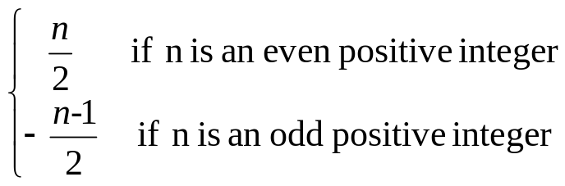
FINITE AND INFINITE SETS
  FINITE SET:
  A set is called finite if, and only if, it is the empty set or there is one-to-one correspondence from {1,2,3,…,n} to it, where n is a positive integer.
  INFINITE SET
  A non empty set that cannot be put into one-to-one correspondence with {1,2,3,…,n}, for any positive integer n, is called infinite set.
CARDINALITY
  Let A and B be any sets. A has the same cardinality as B if, and only if, there is a one-to-one correspondence from A to B.
  COUNTABLE SET
  A set is countably infinite if, and only if, it has the same cardinality as the set of positive integers Z⁺.
  A set is called countable if, and only if, it is finite or countably infinite.
  A set that is not countable is called uncountable.
EXAMPLE
  The set Z of all integers is countable.
  SOLUTION
  We find a function from the set of positive integers Z⁺ to Z that is one-to-one and onto.
  Define f: Z⁺ →Z by
  f(n) =

Slide 15


EXERCISE
  Then f clearly maps distinct elements of Z⁺ to distinct integers. Moreover, every integer m is the image of some positive integer under f. Thus f is bijective and so the set Z of all integers is countable (countably infinite)
  Show that the set 2Z of all even integers is countable.
  SOLUTION
  Consider the function h from Z to 2Z defined as follows
  h(n) = 2n for all n∈Z
  Then clearly h is one-to-one. For if
  h(n₁) = h(n₂) then
  2n₁ = 2n₂ (by definition of h)
  ⇒ n₁ = n₂
  Also every even integer 2n is the image of integer n under h. Hence h is onto as well. Thus h:Z →2Z is bijective. Since Z is countable, it follows that 2Z is countable.
IMAGE OF A SET
  Let f : X →Y be a function and A ⊆ X.
  The image of A under f is denoted and defined as:
  f(A) = {y∈Y | y = f(x), for some x in A}
  EXAMPLE Let f: X →Y be defined by the arrow diagram
f
1
2
3
4
.a
b
c
Let A = {1,2}and B = {2,3} then
f(A)={b} and f(B) = {b,c}

Slide 16
INVERSE IMAGE OF A SET
  Let f: X →Y be a function and C ⊆ Y.
  The inverse image of C under f is denoted and defined as:
  f⁻¹(C)={x ∈X | f(x) ∈C}
  EXAMPLE
  Let f: X →Y be defined by the arrow diagram.
f
X
Y
1
a
2
b
c
3
d
4
  Let C = {a},D = {b,c},E = {d} then f⁻¹(C)={1,2}, f⁻¹(D) = {3,4}, and
  f⁻¹(E) =∅

Slide 17
SOME RESULTS
Let f: X →Y is a function. Let A and B be subsets of X and C and D be subsets of Y.
1. if A⊆ B then f(A) ⊆ f(B)
2. f(A∪B) = f(A) ∪f(B)
3. f(A∩B) ⊆ f(A) ∩ f(B)
4. f(A-B) ⊇ f(A) - f(B)
5. if C ⊆ D, then f⁻¹(C) ⊆ f⁻¹(D)
6. f⁻¹(C∪D) = f⁻¹(C) ∪ f⁻¹(D)
7. f⁻¹(C∩D) = f⁻¹(C) ∩f⁻¹(D)
8. f⁻¹(C-D) = f⁻¹ (C) - f⁻¹ (D)

